Slide 1

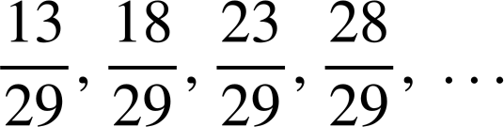
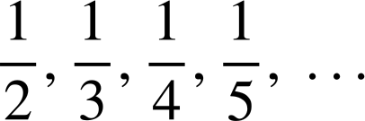
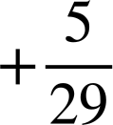

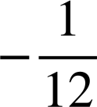
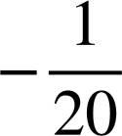
Checking understanding of arithmetic sequences
Task A: Identifying arithmetic sequences
1) Label these sequences as ‘arithmetic’ or ‘not arithmetic’.
a) 9, 13, 17, 21, 25, …
b) 37, 31, 25, 19, 13, …
+4
+4
+4
+4
Arithmetic
−6
−6
−6
−6
Arithmetic
c) −70, −68, −66, −64, −62, …
d) 35, 31, 26, 20, 13, …
+2
+2
+2
+2
Arithmetic
−4
−5
−6
−7
Not arithmetic
e) 12.6, 13.7, 14.8, 15.9 …
f) 3, 6, 12, 24, 48, …
+1.1
+1.1
+1.1
Arithmetic
+3
+6
+12
+24
Not arithmetic
g)
h)
Arithmetic
Not arithmetic
Task B: Checking understanding of arithmetic sequences
1) Find the first five terms of these three sequences:
a) 3n + 7
b) 3n − 7
Term number (n) | 1 | 2 | 3 | 4 | 5
Term (T) | 10 | 13 | 16 | 19 | 22
Term number (n) | 1 | 2 | 3 | 4 | 5
Term (T) | −4 | −1 | 2 | 5 | 8
c) 0.3n + 7
d) 7 − 3n
Term number (n) | 1 | 2 | 3 | 4 | 5
Term (T) | 7.3 | 7.6 | 7.9 | 8.2 | 8.5
Term number (n) | 1 | 2 | 3 | 4 | 5
Term (T) | 4 | 1 | −2 | −5 | −8

Slide 2
Checking understanding of arithmetic sequences
2) Find the 10th, 50th, and 100th terms of these sequences.
a) 9n + 6
n = 10, T = 9n + 6 = 9(10) + 6 = 96
n = 50, T = 9n + 6 = 9(50) + 6 = 456
n = 100, T = 9n + 6 = 9(100) + 6 = 906
b) 9n − 6
n = 10, T = 9n − 6 = 9(10) − 6 = 84
n = 50, T = 9n − 6 = 9(50) − 6 = 444
n = 100, T = 9n − 6 = 9(100) − 6 = 894
c) 0.9n + 0.6
n = 10, T = 0.9n + 0.6 = 0.9(10) + 0.6 = 9.6
n = 50, T = 0.9n + 0.6 = 0.9(50) + 0.6 = 45.6
n = 100, T = 0.9n + 0.6 = 0.9(100) + 0.6 = 90.6
d) 6 − 9n
n = 10, T = 6 − 9n = 6 − 9(10) = −84
n = 50, T = 6 − 9n = 6 − 9(50) = −444
n = 100, T = 6 − 9n = 6 − 9(100) = −894

Slide 3


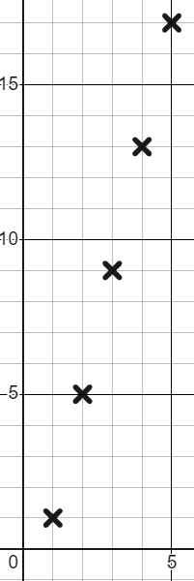
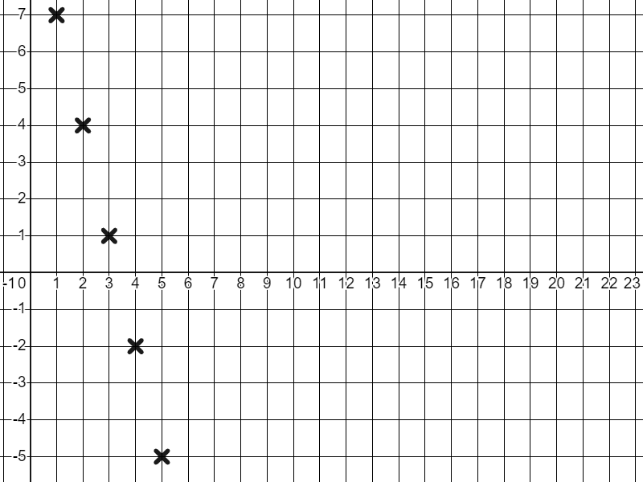
Checking understanding of arithmetic sequences
Task C: Representations of arithmetic sequences
1) Draw a visual representation for the first five terms of these sequences:
a) 5, 7, 9, 11,13, …
b) 13,10, 7, 4, 1
c) 5n + 1
Examples of what they might look like:
n | 1 | 2 | 3 | 4 | 5
T | 6 | 11 | 16 | 21 | 26
In each case the linear structure of the sequence is revealed.
2) Plot the first five terms of these sequences:
a) 4n − 3
b) 10 − 3n
n | 1 | 2 | 3 | 4 | 5
T | 1 | 5 | 9 | 13 | 17
n | 1 | 2 | 3 | 4 | 5
T | 7 | 4 | 1 | −2 | −5
T
T
n
n
Mathematics in Education and Industry.
v2.3

